Slide 1

Data Apex
NYPD 911 Calls Analysis
Ingrid Razemba
Delight Marumani
Simbarashe Razemba

Slide 2
Project Sponsor
Sarah Thompson - Director of Emergency Management (NYCEM)
Responsibility: Leads emergency response planning & resource allocation.
Pain Point
NYPD is overloaded with 911 calls—especially non-criminal ones.
NYPD receives the most funding but often overspends.
Needs accurate data to rebalance responder workloads.
Why This Project Matters
Sarah required insight into:
The true workload placed on NYPD
How many calls could be redirected to EMS, FDNY, or social services
How call patterns may affect budgeting for FY2026
Opportunities to reduce NYPD burnout and improve response efficiency

Slide 3
Objectives
Identify patterns in NYPD-handled 911 calls
Determine which calls require non-police responders
Support FY2026 budget decisions
Reduce NYPD workload by diverting non-criminal calls
Improve coordination across responder agencies (NYPD, FDNY, EMS, etc.)

Slide 4
Executive Summary
This analysis highlights:
High volume of non-criminal calls (93%)
Workload imbalances across boroughs
Peak call times and seasonal patterns
Prolonged handling times for certain call types
Opportunities for targeted staffing, resource reallocation, and call diversion strategies
Goal: Build a data-driven foundation for FY2026 emergency response planning.

Slide 5
Methodology
Methodology & Tools
Data Sources: NYPD 911 call records (2023–2024)
Approach:
Cleaned & categorized call types
Aggregated call data by borough, hour, month
Computed KPIs (Load Index, Repeat Caller Rate, Handling Time)
Identified inefficiencies & bottlenecks
Tools: Tableau (visualization, KPI dashboards)

Slide 6
Key Insights
Key Insights Identified
Borough with highest call volume
Call types with highest frequency
Response time variations
Peak call hours and months
Percentage of repeat callers
Workload distribution across patrol boroughs

Slide 7
Visualization Insights

Slide 8
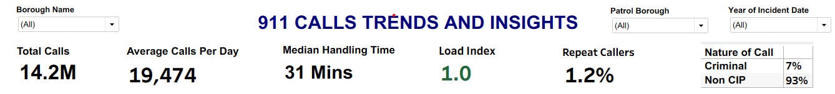
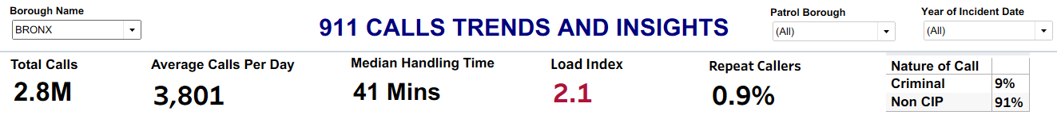
Key KPIs
Description: These KPIs summarize the critical metrics in analyzing call trends and load distribution across patrol Boroughs. Non-criminal calls dominate (93%).
Problem identified: Bronx is overloaded with a load index of 2.1 and handling time of 41 minutes. Significant imbalance in workload across boroughs
Strategy: A second patrol or redistributing resources improves Bronx response capacity
Notes:
Brooklyn 1.1, Manhattan 0.9, Queens 0.8, Staten Island 0.3
Load Index measures workload versus call-handling capacity during a set time. It shows if demand is below, at, or above capacity. • < 1.0: Capacity exceeds demand (manageable) • ≈ 1.0: Team is fully loaded • > 1.0: Demand exceeds capacity (overload)

Slide 9
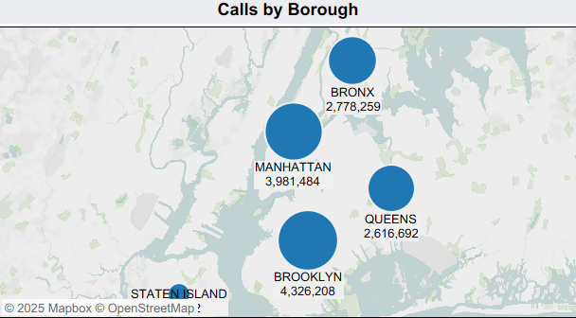
Calls by Borough (Map)
Insights: Brooklyn handles the most calls, followed by Manhattan. The Bronx and Queens have similar call volumes, about 1.5 million fewer than Brooklyn and Manhattan. Staten Island receives the fewest calls.
Strategy: Educate communities on 311 for Non-Emergency Calls instead of 911, Establish Community Responder Programs for specific low-risk calls
Notes:
Staten Island 533 k

Slide 10
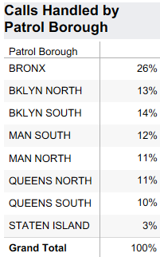
Calls handled By Patrol Borough
Insights: The Bronx processes the most calls at 26% of the total. Staten Island handles the fewest, with just 3%.
Problem identified: The data highlights a significant imbalance in the volume of calls handled by different boroughs.
Strategy: Implement a Data-Driven Workload Model, Reconfigure Patrol Boundaries, Strategic Officer Assignment.

Slide 11
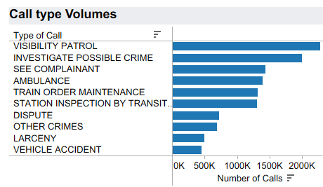
Call Type Volumes
Insights: Graph shows that Visibility Patrol and Investigate Possible Crime are the top 2 most common call types and there are only 3 criminal calls types out of the top 10.
Problem Identified: NYPD is investing a lot of resources in managing low urgent and non-critical calls.
Strategy: Redirect non-criminal and non-critical calls (93% of all calls) to appropriate responders such as:
Health services -EMS
Social workers - domestic disputes, substance abuse cases
Community crisis response teams
Neighborhood Watch - visibility patrol issues
Notes:
A visibility patrol means increasing the presence of law enforcement, often in marked vehicles or on foot, to deter crime and ensure public safety

Slide 12
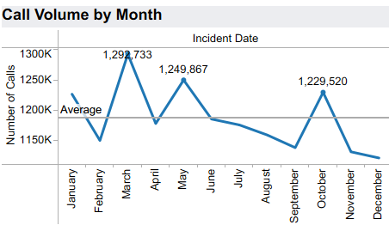
Call Volume by Month
Insights: Line graph highlights peak months (March, May, October).
Spikes are mainly linked to major holidays/events (March- St Patrics Day, October-Halloween, May- Mother’s day, Memorial day, Cinco de mayo).
Strategy: Seasonal staffing adjustments, Predictive scheduling to match expected spikes.
Notes:
March- St Patrics Day, October-Halloween, May- Mother’s day, Memorial day, Cinco de mayo

Slide 13
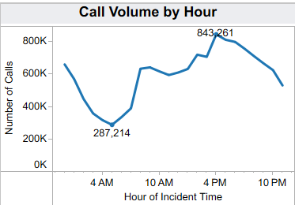
Call Volume by Hour
Insights: Graph highlights daily spikes 4pm – 6 pm. 4 am with the least calls.
Strategy: Shift staffing levels to match daily peaks, Align patrol & support teams to peak activity windows

Slide 14
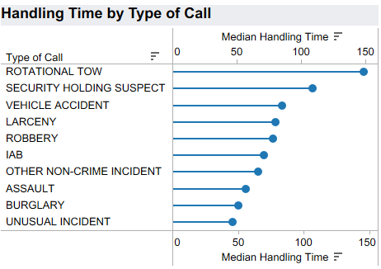
Handling Time
Insights: Rotational Tows and Suspect Holding Requires Extended Time
Most Incidents Handled Moderately: Vehicle accidents, larceny, robbery, IAB, and assault calls generally fall within a median range of 60 to 90 minutes.
Problem identified: Rotational tow and suspect holding demand significant operational resources.
Strategy: Automate tow request workflows, Improve communication with tow partners, Streamline data entry for long-duration call types
Notes:
Efficient communication - Integrate systems and GPS to link dispatch, officers, and tow companies for real-time updates and faster response.
Formalized Tow Service Agreements (TSAs): Formal agreements with specific performance measures for response and clearance times ensure that contracted tow operators are competent and arrive with minimal delays.
Optimize Workflow and Data Entry: Use integrated systems that allow officers to enter data across multiple systems with minimal effort, reducing redundant after-call work (ACW). This minimizes the time spent on manual input.

Slide 15
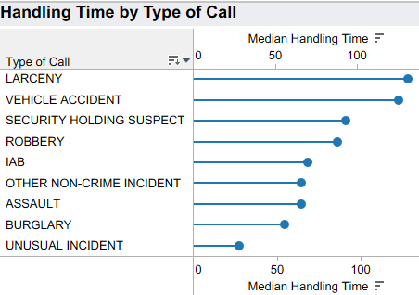
Handling Time - Bronx
Insights: While most calls are non-criminal, crime calls take the longest time to handle.
Problem Identified: Bronx is heavily burdened by non-criminal volume + slow handling times
Strategy: Free Up Resources by diverting non-criminal calls, Introduce efficiency-focused process improvements
Notes:
Efficient communication - Integrate systems and GPS to link dispatch, officers, and tow companies for real-time updates and faster response.
Formalized Tow Service Agreements (TSAs): Formal agreements with specific performance measures for response and clearance times ensure that contracted tow operators are competent and arrive with minimal delays.
Optimize Workflow and Data Entry: Use integrated systems that allow officers to enter data across multiple systems with minimal effort, reducing redundant after-call work (ACW). This minimizes the time spent on manual input.

Slide 16
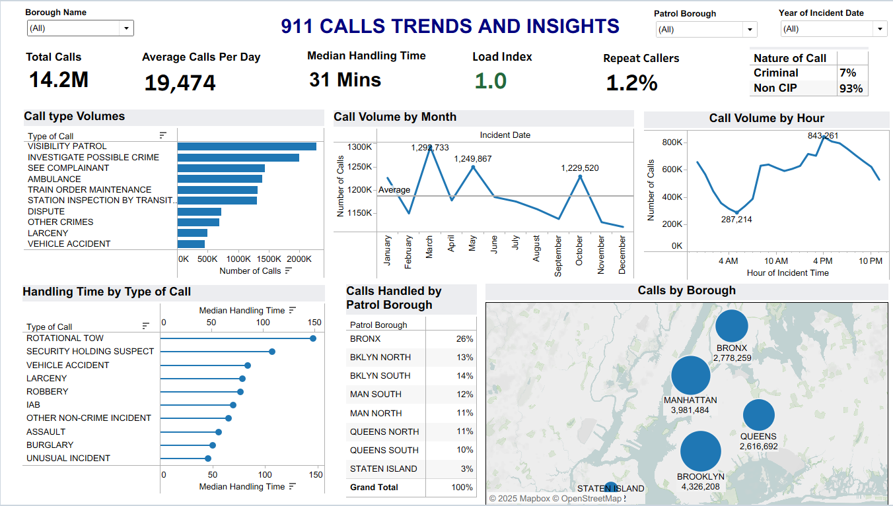
Dashboard

Slide 17
Recommendations and Actions
Key Recommendations
Multi-Agency Response System (MARS)
Divert wellness, domestic, and low-risk calls to EMS, social services, and community teams.
Community Awareness Campaign
Educate residents on when to use 311 vs. 911.
Reallocate Resources to High-Demand Boroughs
Add a new patrol or redistribute officers—focus on Bronx.
Time-Based Staffing
Align scheduling with hourly and seasonal peaks.
Improve High-Duration Call Types
Target rotational tows & suspect holding for workflow improvement (AI-enabled triaging).

Slide 18
Conclusion
Key Takeaways
NYPD's workload is dominated by non-criminal calls
Data shows clear borough-based workload imbalances
Efficient response requires strategic resource allocation
A multi-agency approach is essential to reduce NYPD overload
Better call triage = faster response + improved community safety
This analysis gives NYCEM the insights needed for smarter, fairer FY2026 budgeting and operational planning.

